Slide 1

College Sports +
Jordan Herman, Juan Alvarado
Advisor: Will Hawkins

Slide 2
Project Goals
1. Develop a Fantasy-style web application centered around NCAA athletes.
2. Implement AI model for score prediction to predict a player's expected points based on factors such as height, weight, position, team, and opponent.
3. Utilize historical game data to train the model for accurate point predictions.
4. Create a multi-sport league with support for football, basketball, baseball, and soccer
5. Ensure a user-friendly interface that allows fans to engage with the game easily.
6. Get player statistics from real-life games to determine games every week.

Slide 3
Intellectual Merits
Design of UI/UX for web application (Angular)
Implementation of client-server relationship
Web-scraping of player data for 4 different sports, including player info, team info, and game statistics
Creation of AI model for score prediction via statistics
Implementation of auth. System, real-time draft system

Slide 4
Broader Impacts
Application can lead to increase in school spirit, interest in sports
By spotlighting often-forgotten college sports like soccer and baseball, CS+ can lead to more opportunities for student athletes
Noteriarty for lesser-known athletes can lead to potential NIL opportunities

Slide 5
Design Specifications - System Overview
Front-End application where users interact, create leagues, draft athletes, join other players, trade athletes, etc.
Back-End hosted in python, OpenAPI interface through FastAPI connects to Front-End
Back-End scrapes data for athletes, sends data to Front-End
Front-End also connected to Firebase for authentication system.

Slide 6
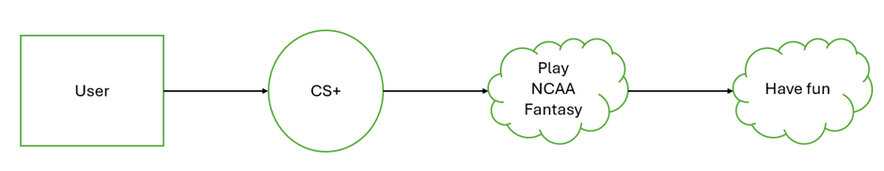
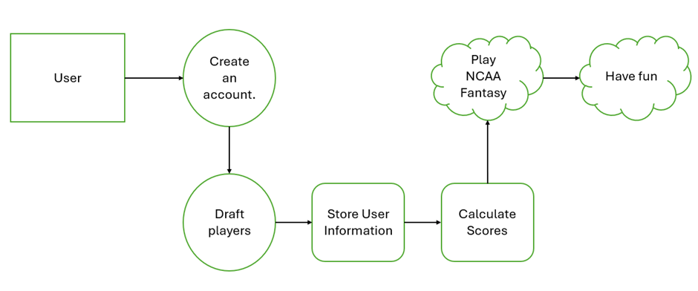
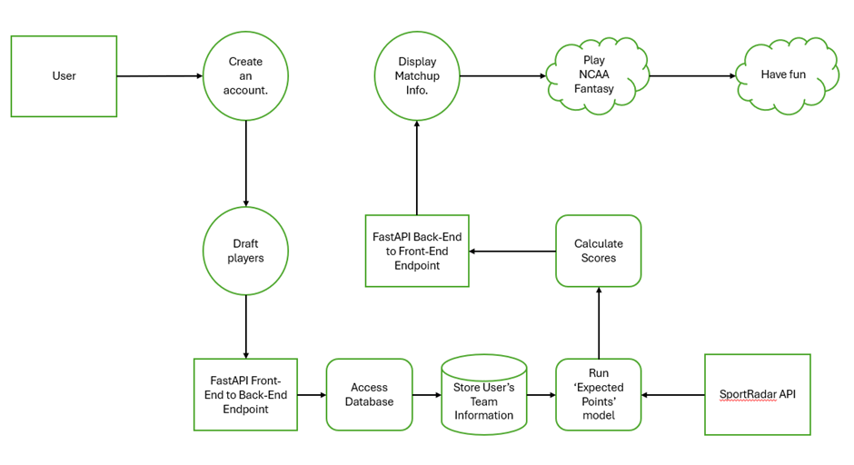
Design Specifications - Design Diagrams

Slide 7
Technologies
Front-End:
Angular
Google Firebase
HTML/CSS
Back-End:
FastAPI
Relevant Libraries (cbbpy, cfbd)
BeautifulSoup
SciKit-Learn

Slide 8
Milestones
Date
9/11/2024
10/2/2024
12/13/2024
12/26/2024
12/29/2024
1/6/2025
1/17/2025
2/3/2024
Milestone
Alpha Version
Initial client build
Draft APIs added for RL-feedback
Full football backend support
First AI Model
Full basketball endpoint support
Full soccer and baseball API support
Authorization system working

Slide 9
Results
Advanced versions of client designed and developed
Models designed for Firestore implementation
Login pages designed for Firebase Authentication Implementation
Web-scraping developed for statistics with NCAA page
Implementation with libraries for ease of use for Football/Basketball
First AI model built for football prediction

Slide 10
Challenges
Dependency on 3rd party APIs and libraries
Legal use of data and rules/laws regarding the NCAA and student athletes
Social constraints with new experience and potential involvement of gambling/betting
Diversity and cultural impact based on availability of the application and accessibility within the UI

